Slide 1
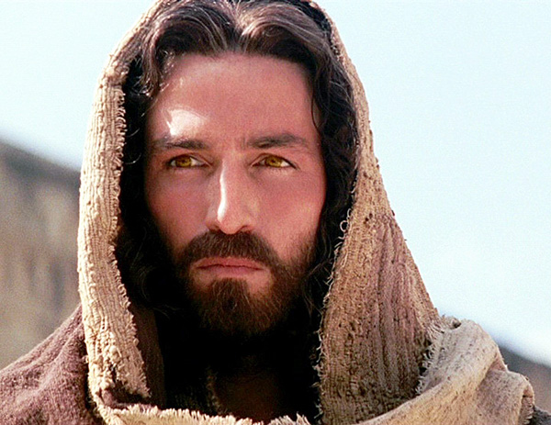
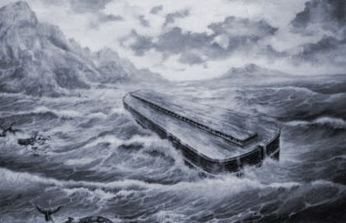
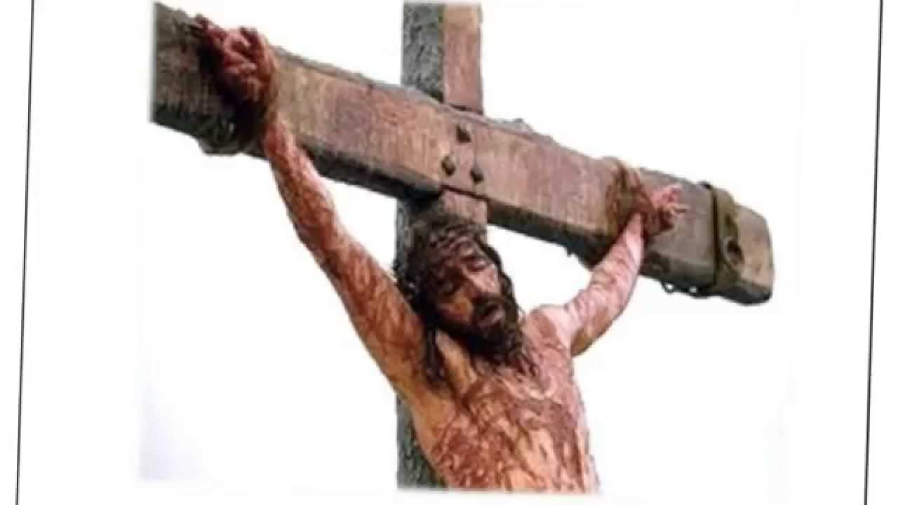
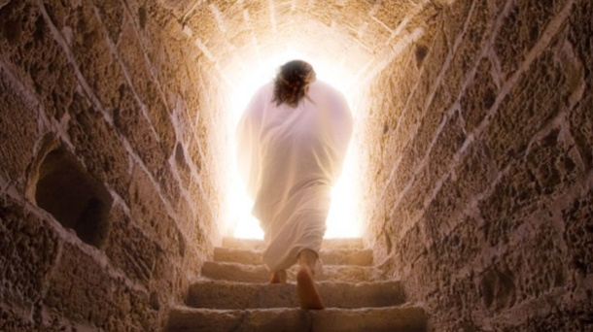
THE FALL

Slide 2
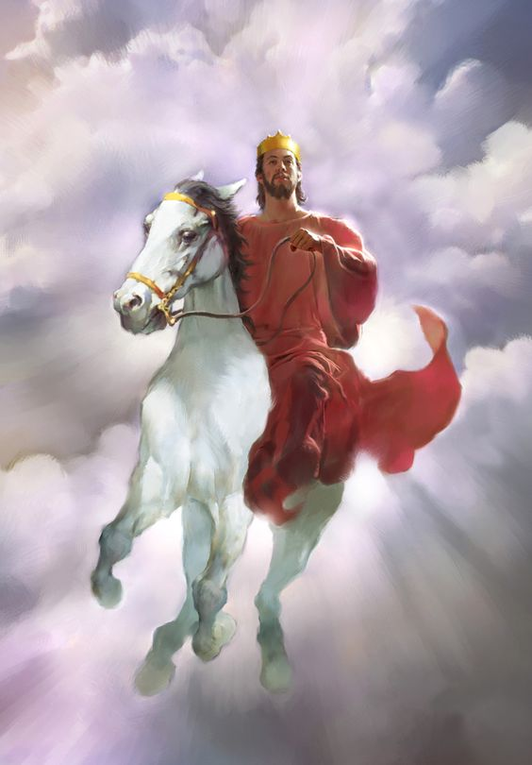
Abram
Everlasting inheritance of land and kingdom
Great Nation
Descendant of greatest king
Rule over
everlasting kingdom

Slide 3
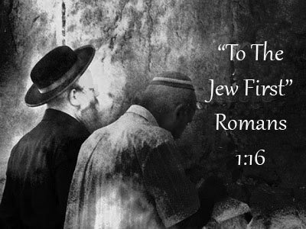
“The Great Commission Part 1: To the Jew First”
Matthew 10:1—15
Topical approach …for application
Israel…kingdom… gospel

Slide 4
I. Jesus’ instruction to us is faithful and His ways serve as the highest example for us to follow
With an eternal perspective, purposefully invest a godly life in people (verses 1-5)
“if we endure, we will also reign with him” 2 Timothy 2:12
Pursue ministry as a team effort (verses 2-4)
Serve for the sake of the gospel in a way that honors God (verses 8-13)

Slide 5
C. Serve for the sake of the gospel in a way that honors God
“There are scriptural paradigms for missionary and ministry activity that recognize dependence both on others’ support and on one’s own resources earned through a different trade. Neither may be made absolute. What is most likely to advance the gospel in an honorable way should be adopted in any given context. A serious danger of paid ministry is that preachers will tailor their message to suit their supporters. A key problem with ‘tentmaking’ is a lack of accountability of ministers to those with whom they work” New American Commentary on verses 8-13

Slide 6
II. Salvation is to the Jew first and rooted in the age-old promise of the coming kingdom of God
Salvation is to the Jew first (verses 5-6)
The gospel is rooted in the age-old promise of the coming kingdom of God (verses 7-8)

Slide 7
B. The gospel is rooted in the age-old promise of the coming kingdom of God
Is there a kingdom in your gospel? Is there a kingdom in your hope for eternity?
Do we not pray “your kingdom come, your will be done on earth as it is in heaven?”
In Acts 28:31, as Paul is living in prison in Rome, Luke writes that Paul welcomed all who came to him, “proclaiming the kingdom of God and teaching about the Lord Jesus Christ with all boldness and without hindrance,” not unlike what Jesus commanded His Disciple’s to proclaim to the lost sheep of Israel

