Slide 1
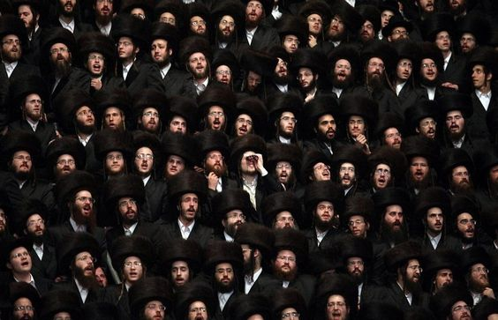
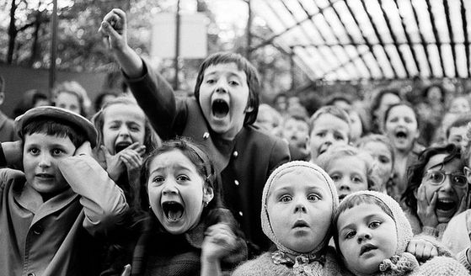
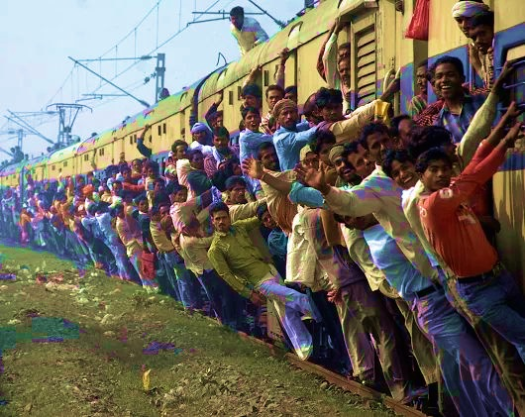
“The Great Commission Part 3: To the Nations!”
Matthew 28:16-20
Salvation:
Church = Agent
Mission = Means
Christ = Effective presence

Slide 2
I. Jesus commands His church to be His agents of salvation blessing to all the nations until the end of the age
Why is Jesus’ command in effect to the end of the age? (verse 20b)
“If anyone loves me, he will keep my word, and my Father will love him, and we will come to him and make our home with him…the Helper, the Holy Spirit, whom the Father will send in my name…will teach you all things and bring to your remembrance all that I have said to you” John 14:23, 26

Slide 3
“God alone, who has told us that this gospel of the kingdom shall be preached in the whole world for a testimony unto all the nations, will know when that objective has been accomplished. But I do not need to know. I know only one thing: Christ has not yet returned; therefore, the task is not yet done. When it is done, Christ will come. Our responsibility is not to insist on defining the terms of our task; our responsibility is to complete it. So long as Christ does not return, our work is not done. Let us get busy and complete our mission!” George Ladd

Slide 4
I. Jesus commands His church to be His agents of salvation blessing to all the nations until the end of the age
Why is Jesus’ command in effect to the end of the age? (verse 20b)
Why does Jesus’ command apply to the church?

Slide 5
I.B. Why does Jesus’ command apply to the church?
“I will surely bless you, and I will surely multiply your offspring as the stars of heaven and as the sand that is on the seashore. And your offspring shall possess the gate of his enemies, and in your offspring shall all the nations of the earth be blessed…” Genesis 22:17-18
“I will build my church, and the gates of hell shall not prevail against it.” Matthew 16:18

Slide 6
II. Jesus commands His church to make disciples as the means of salvation
Disciple making entails some aspects plainly found in our text
Disciple making entails “baptizing them in the name of the Father and of the Son and of the Holy Spirit” (19b)
Disciple making entails “teaching them to observe all that I have commanded you” (20a)

Slide 7
II. Jesus commands His church to make disciples as the means of salvation
Disciple making entails some aspects plainly found in our text
The mission of disciple-making begins with salvation: hearing and believing the gospel (verse 19)
“But when the disciples gathered about him, he rose up and entered the city, and on the next day he went on with Barnabas to Derbe. When they had preached the gospel to that city and had made many disciples, they returned to Lystra and to Iconium and to Antioch.” Acts 14:20-21

Slide 8
II. Jesus commands His church to make disciples as the means of salvation
Disciple making entails some aspects plainly found in our text
The mission of disciple-making begins with salvation: hearing and believing the gospel (verse 19)
Disciple making across the divide which separates us: Kary Oberbrunner’s story

Slide 9
III. Jesus promises to always be with His church in its disciple making mission
Matthew 28:20 – “And behold, I am with you always, to the end of the age.”
Matthew 1:22-23 – “All this took place to fulfill what the Lord had spoken by the prophet: ‘Behold, the virgin shall conceive and bear a son, and they shall call his name Immanuel’ (which means, God with us)”

