Slide 1
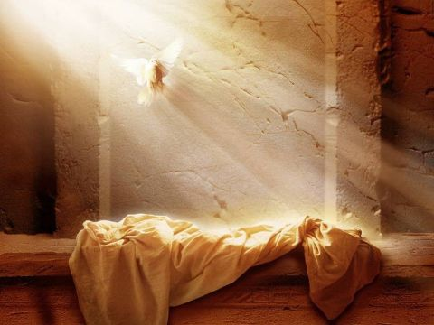
He is Risen!!!

Slide 2
“Who Are We?”
John 21:15-19

Slide 3
“Who Are We?”
Graciously Restored!

Slide 4
Graciously Restored
Jesus graciously restores us by binging us back to the point of our rebellion against His will

Slide 5
Graciously Restored
Jesus graciously restores us by directly addressing our failure
Outward actions
Inward attitudes

Slide 6
“Who Are We?”
Graciously called for the glory of God!

Slide 7
Graciously Restored applied…
To the person who has not come to faith in Jesus Christ

Slide 8
Graciously Restored applied…
To the follower of Jesus Christ
Grace has an eternal aim
Grace opposes… what obstructs His favor

Slide 9
He is Risen!!!

