Slide 1
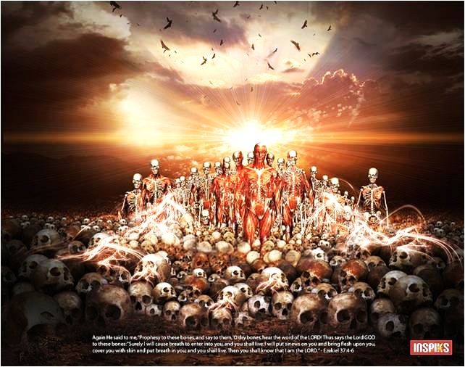
“Fresh Hope for Dry Bones”
Ezekiel 37:1-4, 21-28
The Lord will:
Resurrect His people Israel
Restore them as a nation

Slide 2
I. The Lord God will resurrect His people Israel

Slide 3
A Letter from Health and Human Services
“Your food stamps will be stopped, effective March 1992, because we received notice that you passed away. May God bless you. You may reapply if your circumstances change.”

Slide 4
I. The Lord God will resurrect His people Israel
The Lord gives Ezekiel a vision of Israel’s resurrection (verses 1-10)
The Lord will resurrect His people in human form (7-8)
The Lord will resurrect His people as living souls (9-10)

Slide 5
I. The Lord God will resurrect His people Israel
The Lord gives Ezekiel a vision of Israel’s resurrection (verses 1-10)
The Lord explains this vision of resurrection to Ezekiel (verses 11-14)
It is Israel who will be resurrected
Israel will be resurrected in order to bring the Lord’s covenant promises to them to pass

Slide 6
II. The Lord God will restore the nation of Israel
The Lord will restore Israel to national unity (verses 21-22)
The Lord will restore Israel to national purity (verses 23-24)
The Lord’s restoration of Israel will be everlasting (verses 25-28)

Slide 7
III. Embrace the hope God has given you!
“If the Spirit of him who raised Jesus from the dead dwells in you, he who raised Christ Jesus from the dead will also give life to your mortal bodies through his Spirit who dwells in you.” Romans 8:11

Slide 8
III. Embrace the hope God has given you!
Life giving resurrection power dwells in the follower of Jesus Christ!
Refrain from false hope

