Slide 1
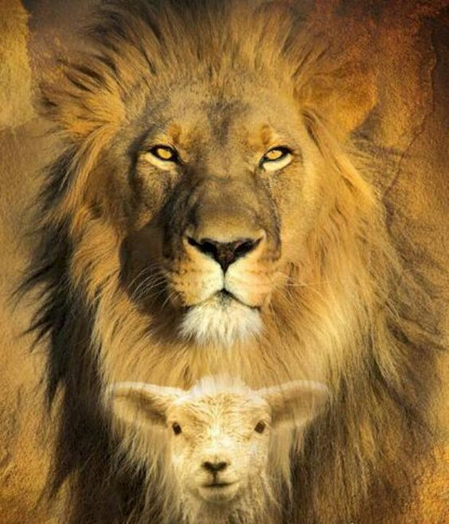
Jesus Messiah, Lion of Judah
The King and the Prophets
Micah 5:1-15

Slide 2
I. The kingdom is the most thoroughly addressed New Testament topic which we never talk about!
The kingdom is present whenever the King and His people are present

Slide 3
The kingdom is present whenever the King and His people are present
“From the days of John the Baptist until now the kingdom of heaven suffers violence, and violent men take it by force” Matthew 11:12
“Now having been questioned by the Pharisees as to when the kingdom of God was coming, He answered them and said, ‘The kingdom of God is not coming with signs to be observed; nor will they say, ‘Look, here it is!’ or, ‘There it is!’ For behold, the kingdom of God is in your midst’” Luke 17:20-21
“The kingdom of the world has become the kingdom of our Lord and of His Christ; and He will reign forever and ever.” Revelation 11:15

Slide 4
I. The kingdom is the most thoroughly addressed New Testament topic which we never talk about!
The kingdom is present whenever the King and His people are present
The kingdom will come when the King returns to this world

Slide 5
The kingdom will come when the King returns to this world
“I say to you that many will come from east and west, and recline at the table with Abraham, Isaac and Jacob in the kingdom of heaven” Matthew 8:11
“Truly I say to you, I will never again drink of the fruit of the vine until that day when I drink it new in the kingdom of God” Mark 14:25

Slide 6
II. The Messiah’s greatness will span the earth and save believing national Israel
The Messiah will restore hope to hopeless Israel (verses 1-3)
The might of Israel will be the might of her Messiah (verses 4-5)

Slide 7
III. The Messiah will make the greatness of His people Israel span the earth
Israel, too little among the nations, becomes a force to be reckoned with among the nations (verses 6-9)
Israel will be mighty because our mighty God will purify His people and be mighty through them (verses 10-15)

Slide 8
“Let not a wise man boast of his wisdom, and let not the mighty man boast of his might, let not a rich man boast of his riches; but let him who boasts boast of this, that he understands and knows Me.”
Jeremiah 9:2324

