Slide 1
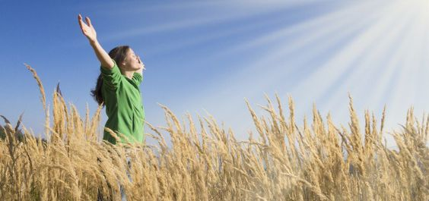
Cultivate an Attitude of Gratitude!
Warning! Close Encounters With The Savior Can Lead You To…
Luke 17:11-19

Slide 2
I. Jesus delivered ten lepers from their uncleanness
These lepers suffered in the isolation of ceremonial uncleanness (verses 11-13)

Slide 3
“As for the leper who has the infection, his clothes shall be torn, and the hair of his head shall be uncovered, and he shall cover his mustache and cry, ‘Unclean! Unclean!’ He shall remain unclean all the days during which he has the infection; he is unclean. He shall live alone; his dwelling shall be outside the camp.”
Leviticus 13:45-46

Slide 4
I. Jesus delivered ten lepers from their uncleanness
These lepers suffered in the isolation of ceremonial uncleanness (verses 11-13)
Jesus determined to heal them of their leprosy (verse 14a)
Jesus delivered all of them from their uncleanness “as they were going” (verse 14b)
Jesus makes a dangerous distinction about saving faith (Luke 4:14-30)
One of these faithful gentiles was a Syrian leper named Naaman

Slide 5
“Behold now, I know that there is no God in all the earth, but in Israel…your servant will no longer offer burnt offering nor will he sacrifice to other gods, but to the Lord”
2 Kings 5:15 & 17

Slide 6
II. Jesus saved a thankful Samaritan leper because of his faith
The Samaritan leper demonstrated an attitude of gratitude (verses 15-16)
Jesus emphatically contrasts the Samaritan’s attitude with the other nine lepers (Verses 17-18)
The Samaritan's attitude of gratitude was the fruit of his saving faith in Jesus (verse 19)
Being saved and being thankful: an illustration

Slide 7
III. Cultivate an attitude of gratitude!
Thank god…
for every moment of his sustaining grace
by thankfully remembering all that he does in our lives
By thanking the people he uses to bless you
Even in moments when thanking him feels out of place

Slide 8
Cultivate an Attitude of Gratitude!

