Slide 1
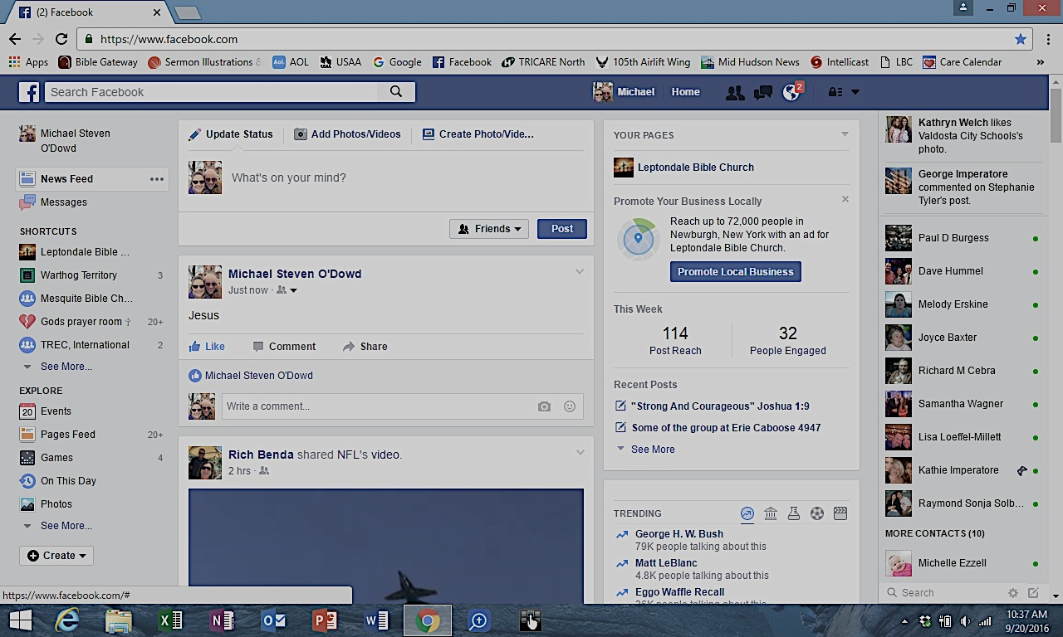
Does this make me a follower?

Slide 2
Leave everything and follow him!
Warning! Close Encounters With The Savior Can Lead You To…
Luke 5:1-11

Slide 3
I. The follower of Jesus Christ gives him their undivided attention
Jesus’ followers give him their undivided attention by focusing on the word of god (verse 1)
Jesus’ followers give him their undivided attention by making him their first priority (verses 2-3)

Slide 4
Jesus’ followers give him their undivided attention by making him their first priority
“Now as they were traveling along, He entered a village; and a woman named Martha welcomed Him into her home. She had a sister called Mary, who was seated at the Lord’s feet, listening to His word. But Martha was distracted with all her preparations; and she came up to Him and said, ‘Lord, do You not care that my sister has left me to do all the serving alone? Then tell her to help me.’ But the Lord answered and said to her, ‘Martha, Martha, you are worried and bothered about so many things; but only one thing is necessary, for Mary has chosen the good part, which shall not be taken away from her.” Luke 10:38-42

Slide 5
Ii. The follower of Jesus Christ chooses obedience over experience (verses 4-5)
Iii. obedience transforms the experience of The follower of Jesus Christ (verses 6-7)
God gives us direction, commands our obedience, and then, through faithful obedience in what we can do, He does what we cannot do…
The challenge was not to their abilities but to their wills.

Slide 6
Iv. The follower of Jesus Christ humbly embraces Jesus as lord and embraces their new identity and purpose in him
Simon Peter discovers a new level of recognition of who Jesus is (verses 8-9)
Simon Peter finds new identity and purpose in Christ (verses 8, 10)

Slide 7
v. Leave everything and follow him!
(verse 11)
Give Christ our undivided attention
Choose obedience to his direction over our own understanding
Embrace reality as a life where this obedience will lead to our experience of his handiwork in and through us
Cast aside all pride of self and embrace the humble posture before Christ as lord of your life, knowing that he has transformed your identity and your life’s purpose

Slide 8
Leave everything and follow him!
Warning! Close Encounters With The Savior Can Lead You To…

