Slide 1
“Before I formed you in the womb I knew you; Before you were born I sanctified you; I ordained you a prophet to the nations.” – Jeremiah 1:5 (NKJV)

Slide 2
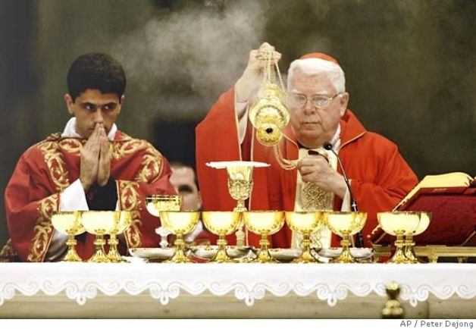

Slide 4
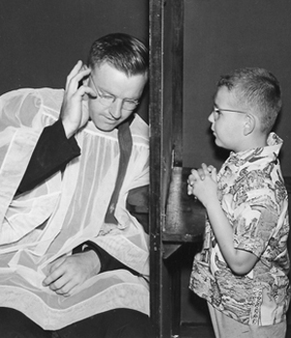

Slide 8
“A man’s heart plans his way, but the Lord directs his steps.” – Proverbs 16:9 (NKJV)

Slide 9
“For I know the thoughts that I think towards you, says the Lord, thoughts of peace and not of evil, to give you a future and a hope.” – Jeremiah 29:11 (NKJV)

Slide 10
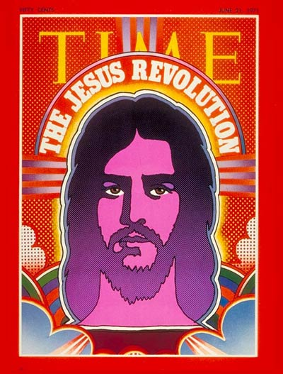

Slide 11
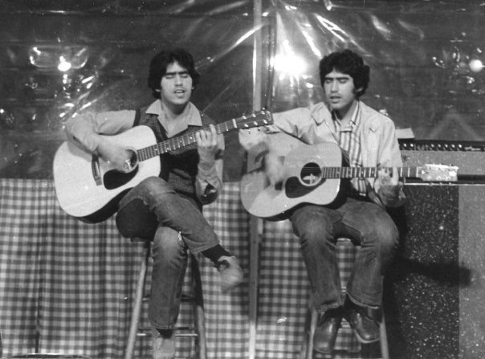

Slide 14
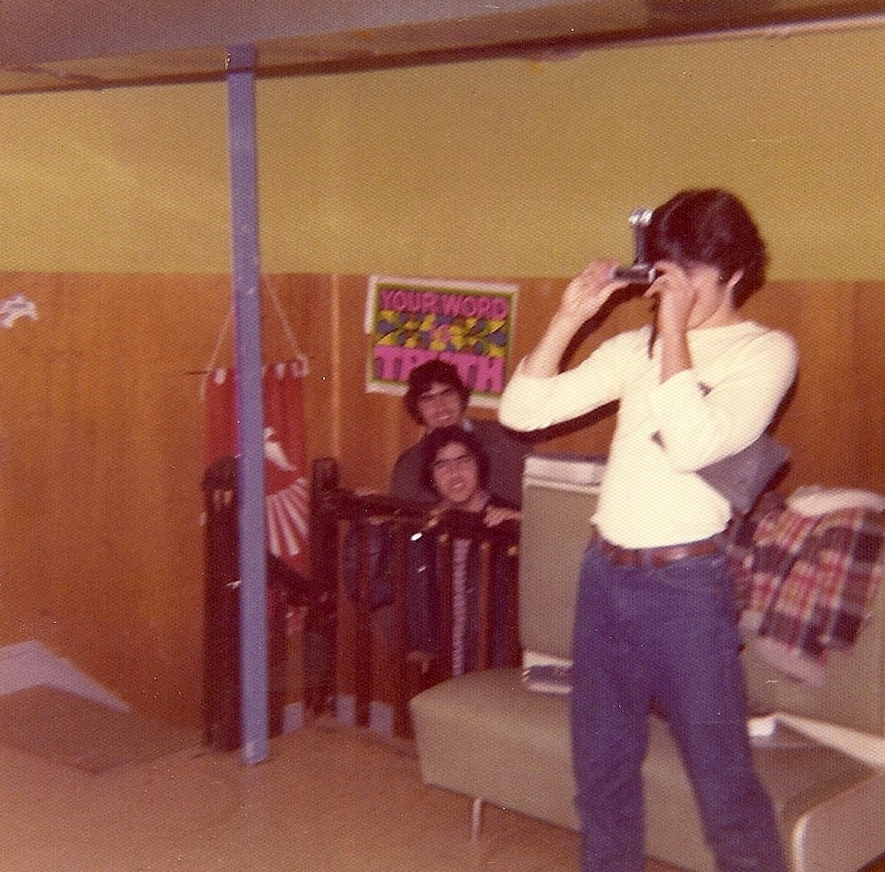

Slide 15
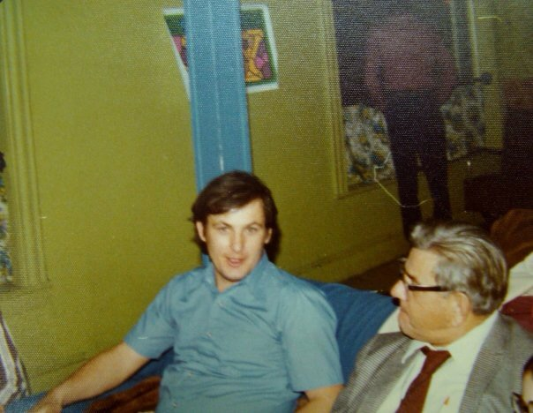

Slide 16
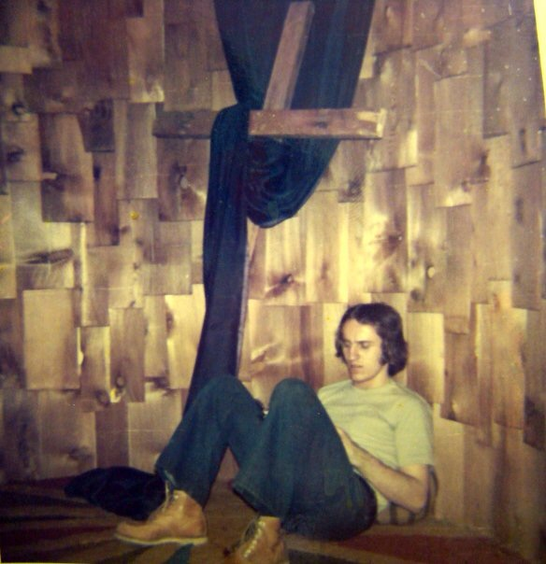

Slide 17
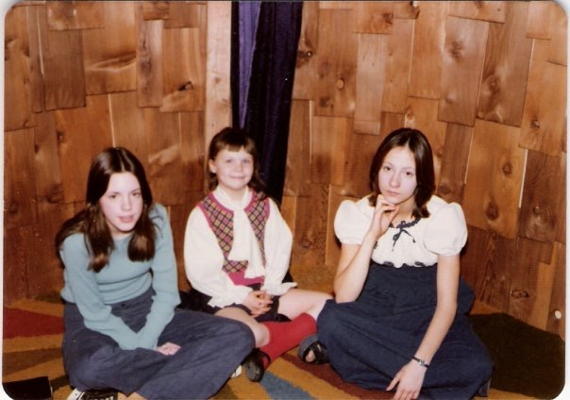

Slide 19
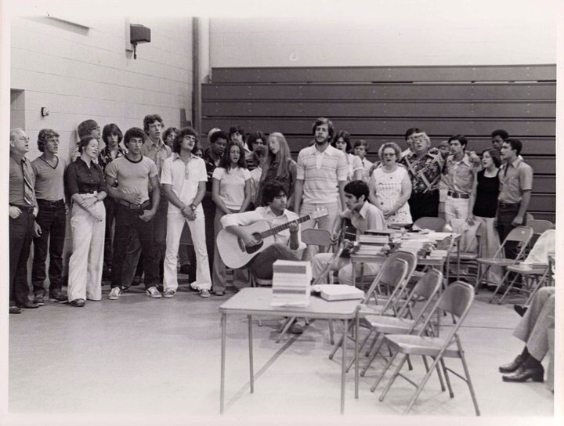

Slide 21
“The Lord is not slack concerning His promise, as some count slackness, but is longsuffering toward us, not willing that any should perish but that all should com to repentance.” – 2 Peter 3:9 (NKJV)

Slide 22
“Do not be deceived, God is not mocked; for whatever a man sows, that he will also reap.” – Galations 6:7 (NKJV)

Slide 23
“There are many plans in a man’s heart, nevertheless the Lord’s counsel – THAT will stand.” – Proverbs 19:21 (NKJV) (Emphasis mine.)

Slide 24
“And we know that all things work together for good to those who love God, to those who are called according to His purpose.” – Romans 8:28 (NKJV)

Slide 25
“Trust in the Lord with all your heart and lean not on your own understanding; In all your ways acknowledge Him, and He shall direct your paths.” – Proverbs 3:5-6 (NKJV)

Slide 26
“Not everyone who says to Me, ‘Lord, Lord’, shall enter the kingdom of heaven, but he who does the will of My Father in heaven.” – Matthew 7:21 (NKJV)

Slide 27
“For I am persuaded that neither death nor life, nor angels nor principalities nor powers, nor things present nor things to come, nor height nor depth, nor any other created things, shall be able to separate us from the love of God which is in Christ Jesus our Lord.” – Romans 8:38-39 (NKJV)

